Slide 1

Stock Price Prediction Using Regression Algorithms
Presented by: Mayur Nikam
Institution: Department of Technology, SPPU
Date: May 24, 2025

Slide 2

Understanding Stock Market Dynamics
Financial Analytics
Strategic Advantage
Stock price prediction is a crucial area in financial analytics.
Accurate forecasting offers significant benefits in trading and investing.
Market Complexity
The volatile nature of markets makes prediction highly challenging.

Slide 3




Forecasting Stock Prices with Machine Learning
Objective
Approach
Gather real-time and historical stock data from the NSE.
Apply regression algorithms to predict stock prices.
Aim
Leverage data models to understand market behavior with accuracy.

Slide 4
Data Collection & Preprocessing
Data Source
Preprocessing Steps
Historical stock data including Open, High, Low, Close, and Date from NSE via "NSEPYTHON" library.
Handling missing values
Ensuring consistency
Converting data types
Reordering data chronologically

Slide 5
Enhancing Data for Better Insights
Feature Engineering
Data Visualization
Creation of moving averages, price change percentages, and trend indicators to boost model accuracy.
Line plots for trend analysis
Future: Candlestick charts and heatmaps for pattern detection

Slide 6





Regression Algorithms for Prediction
Linear Regression
Decision Tree Regression
Random Forest Regression
Models linear relationships between variables.
Captures non-linear and complex data patterns.
Ensemble of decision trees for improved accuracy and robustness.
Support Vector Machine (SVM):
K-Nearest Neighbors (KNN):
A non-parametric, instance-based learning algorithm.
A powerful and versatile model for both linear and non-linear regression.

Slide 7
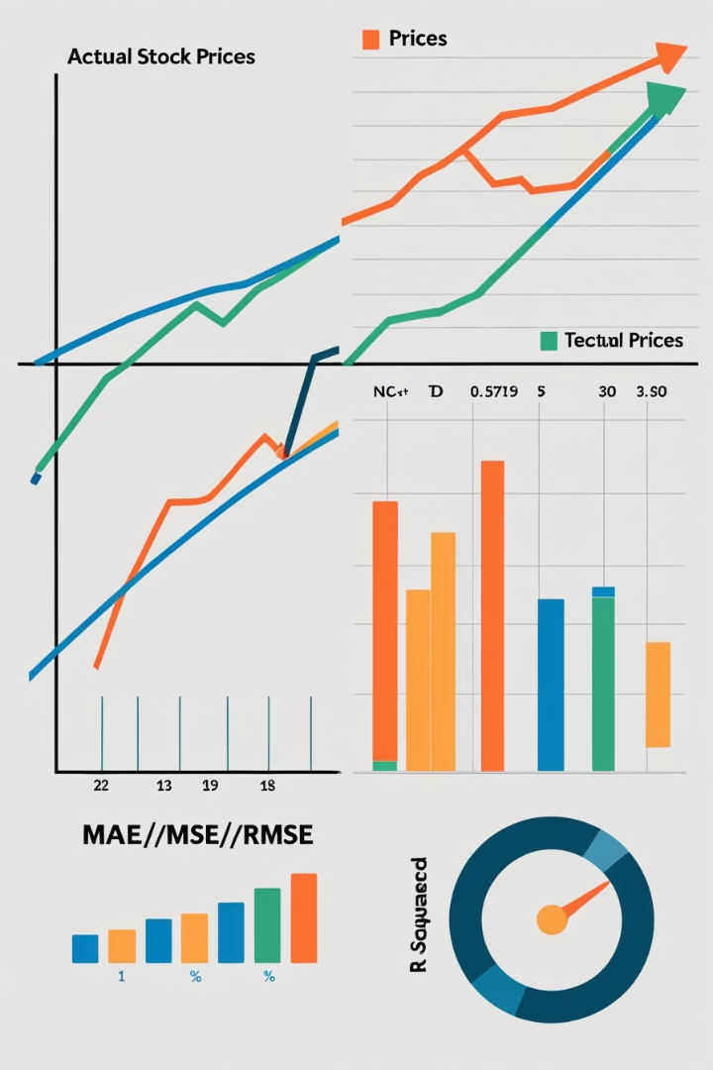




Assessing Performance & Forecasting
Mean Absolute Error (MAE)
Average error magnitude across predictions.
Mean Squared Error (MSE)
Penalizes larger errors emphasizing significant deviations.
R-squared Score (R²)
Proportion of variance explained by the model.
Root Mean Squared Error (RMSE)
The square root of MSE, providing error in the same units as the target variable.
Best model predicted future prices, validated by close alignment to actual data.

Slide 8
Tools and Technologies
Languages & IDE
Key Libraries
Python
nsepython for NSE data extraction
Jupyter Notebook, VS Code
pandas, numpy for data manipulation
matplotlib, seaborn for visualization
scikit-learn for regression modeling

Slide 9

Key Takeaways & Future Outlook
Project Summary
Demonstrated regression models' effectiveness for stock price prediction.
Accuracy & Limitations
Achieved good accuracy but acknowledged market volatility's uncertainty.
Future Scope
Integrate sentiment analysis, deep learning models, and real-time streaming.
User Interaction
Develop interactive forecasting tools for end-users.

